Slide 1
Meta-cognition and learning from high-dimensional streaming data
Dr Savitha Ramasamy
Senior Scientist
Institute of Infocomm Research
Agency for Science, Technology and Research
Singapore
Email: ramasamysa@i2r.a-star.edu.sg

Slide 2
ML for Predictive Analytics
Fixed architecture
Eg: Back propagation
Regression
Eg: Weather prediction
Dynamic architecture
Eg: Online/sequential learning; concept drift; feature drift etc
Stationarity of data
Nature of
problem
ML for Predictive Analytics
Classification
Eg: Fault Detection and Prediction
Nature of Signals
Real-valued networks
Eg: Temperature prediction
Complex-valued/Quaternion networks
Eg: Wind prediction, QAM signal processing

Slide 3
Presentation Outline
High Dimensional Neural Networks
Why Complex-valued Neural Networks?!
Fully Complex-valued Neural Networks
Fully Complex-valued Multi Layer Perceptron (FC-MLP)
Improved Complex-valued Multi Layer Perceptron (IC-MLP)
Fully Complex-valued RBF (FC-RBF) network
Issues
Meta-cognition in High Dimensional Neural Networks
Towards Online Learning in Restricted Boltzmann Machine
Continual Learning: Continual Learning for Time-series Data

Slide 4
Refreshing Basics: Complex-valued Variables

Slide 5
Need for Complex-valued Neural Networks
Needs:
In Typical Applications like
Medical Image processing:
N. Sinha and M. Saranathan and K. R. Ramakrishna and S. Suresh, “Parallel magnetic resonance imaging using neural networks,” IEEE International Conference on Image Processing, vol. 3, pp. 149-152, 2007.
Signal processing/ wireless communications
C. Shen, H. Lajos and S. Tan, “Symmetric complex-valued RBF receiver for multiple-antenna-aided wireless systems,” IEEE Trans. on Neural Networks, vol. 19, no. 9, pp. 1659 - 1665, 2008.
Radar signal processing
C. C. Yang and N. K. Bose, “Landmine detection and classification with complex-valued hybrid neural network using scattering parameters dataset,” IEEE Transactions on Neural Networks, vol. 16, no. 3, pp. 743-753, 2005.

Slide 6
Split Complex-valued Multi Layer Perceptron
Real-valued inputs, network parameters & Real-valued activation function
Input weights
Output weights
1
1
1
2m
2n
h
2n output neurons

Slide 7
Learning Algorithm in SC-MLP
Hidden layer output:
Network Output:
Weight Updates:
Issues:
1. Real-valued parameters, real-valued gradients
2. Significant loss of phase information

Slide 8
Some Definitions
Entire functions [14]:
An entire function is a function that is analytic at each point in the entire finite plane.
Analytic or Regular or Holomorphic Functions [14]:
A function f(z) of a complex variable z is analytic in an open set if it has a derivative at each point in the set.

Slide 9
Liouville’s Theorem [14]
If f(z) is entire and bounded in the complex plane, then f(z) is constant throughout the Complex plane.
That is, every holomorphic function f(z) for which there exists a positive number M such that |f(z)| ≤ M for all z in C is constant.
A constant cannot be used as an activation function!!!!!

Slide 10
Fully Complex-valued MLP: Activation Functions (Adali)
Essential Properties for a fully complex-valued activation function [1]
Non-linear
Analytic and bounded almost everywhere
Elementary Transcendental Functions (ETF) with finite singularities [1, 15]. (Examples of ETF: asinh, atanh, atan, asin etc…)
[2] T. Kim, and T. Adali, “Fully complex-valued multi-layer perceptron networks for nonlinear signal processing,” Journal of VLSI Signal Processing, vol. 32, no.1-2, pp. 29-43, 2002.
[15] T. Kim and T. Adali, “Approximations by fully complex multilayer perceptrons,” Neural Computation, vol. 15, no. 7, pp. 1641-1666, 2003.

Slide 11
Fully Complex-valued MLP: Activation Functions (Adali)
Singularity:
If a function f is not differentiable at a point z₀, but is differentiable at every neighborhood of z₀, it is said to be singular at z₀.
Consider atanh(z):
However, it has finite values in the neighborhood of 1.
Eg. atanh(1.001) = 3.8007 + 1.5708i
Hence, atanh has a singularity at 1.

Slide 12
Fully Complex-valued Multi Layer Perceptron (Adali)
Complex-valued parameters and complex-valued activation functions (ETF [2] )
Input weights
Output weights
1
1
1
m
n
m input neurons
h
n output neurons
h hidden neurons

Slide 13
Fully Complex-valued MLP
FC-MLP
Learning Rule
Hidden layer response:
Network Output:
Error function used:
Output weight update:
Input weight update:
Issues:
Finite singularities of activation functions: convergence problems.
2. Root mean squared error function : phase?

Slide 14
Issues in Fully Complex-valued MLP
Relaxed condition for activation function:
Essential Properties for a fully complex-valued activation function [1]
Non-linear
Analytic and bounded almost everywhere
Elementary Transcendental Functions (ETF) with finite singularities [1, 2]. (Examples of ETF: asinh, atanh, atan, asin etc…)
Issues:
Fully complex-valued multi-layer perceptron:
Uses mean squared error function that is not an explicit representation of the phase.
Activation functions have finite singularities: affects convergence – serious problem.
[1] H. Leung and S. Haykin, “The Complex backpropagation algorithm,” IEEE Transactions on Signal Processing, vol. 39, no. 9, pp. 2101-2104, 1991.
[2] T. Kim and T. Adali, “Approximations by fully complex multilayer perceptrons,” Neural Computation, vol. 15, no. 7, pp. 1641-1666, 2003.

Slide 15
Improved Complex-valued Multi Layer Perceptron (IC-MLP)
‘exp’ activation function in the output layer
Uses an error function that is an explicit representation of magnitude and phase

Slide 16
Introducing coefficients k₁ and k₂ and simplifying,

Slide 17
Weight Update Rule using Logarithmic Error Function and complex gradients
Output Weight Update:
Input Weight Update:

Slide 18
Complex-valued Radial Basis Function Network [3]
Complex-valued weights and neuron centers
1
1
1
m
n
h
m input neurons
h hidden neurons
Output weights
n output neurons

Slide 19
Hidden layer response:
Network update rules:
Network output:
Issues:
Phase information lost at hidden layer
Gradients not fully complex-valued; correlation between real/imaginary parts of error lost!

Slide 20
Fully Complex-valued Radial Basis Function Network
Key features:
Gradient descent based batch learning algorithm.
Fully complex-valued Gaussian-like ‘sech’ activation function: symmetric about the Real axis, maps
Fully complex-valued Gradients.
Preserves phase information.

Slide 21
Fully Complex-valued Radial Basis Function Network
1
Complex-valued input/hidden layer parameters
fully complex-valued activation function
1
1
n
m
h
Output weights
n output neurons
m input neurons
h hidden neurons

Slide 22
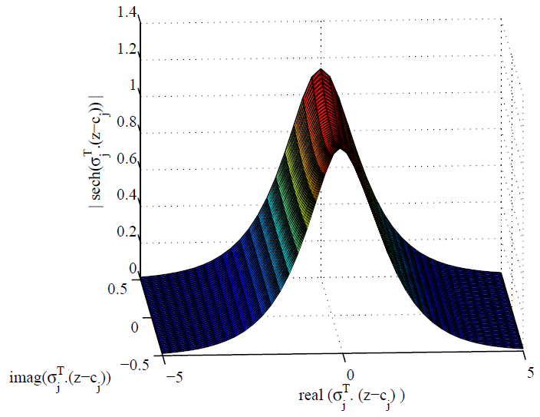
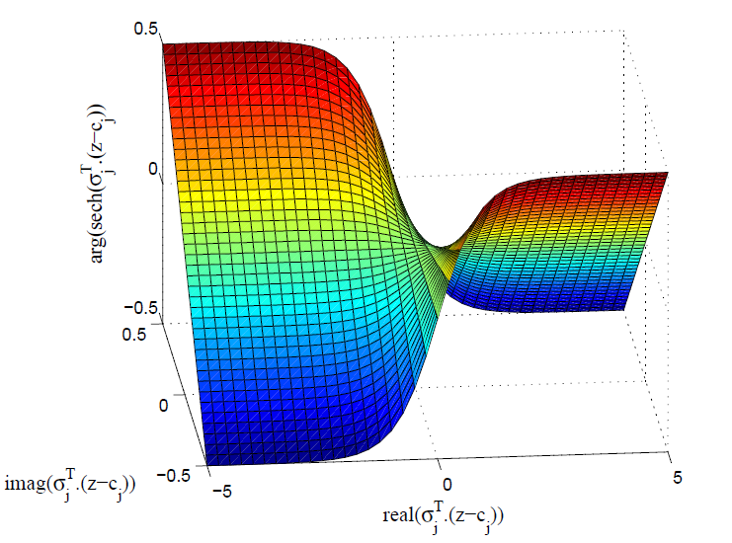
Activation function: ‘sech’

Slide 23
Fully Complex-valued Radial Basis Function Network: Learning Algorithm
Network Output:
Parameter Updates:

Slide 24
ML for Predictive Analytics
Fixed architecture
Eg: Back propagation
Regression
Eg: Weather prediction
Dynamic architecture
Eg: Online/sequential learning; concept drift; feature drift etc
Stationarity of data
Nature of
problem
ML for Predictive Analytics
Classification
Eg: Fault Detection and Prediction
Nature of Signals
Real-valued networks
Eg: Temperature prediction
Complex-valued/Quaternion networks
Eg: Wind prediction, QAM signal processing

Slide 25
What then?
Data is non-stationary
Training data and testing data need not come from the same distribution
Architecture of the network?!
Are there inspirations from human learning?

Slide 26

Meta-cognition in Human Beings
Self-regulated learning is the best learning strategy [6],[7],[8]
Student control their learning process not teacher
Set their own goal (plan)
Identify what to learn and choose material: video lecture, book, (monitor)
Get feedback on their understanding (manage)
Human meta-cognition controls the learning process
Class Room Learning
[6] Wenden, A. L. (1998). Metacognitive knowledge and language learning. Applied Linguistics, 19(4), 515–537.
[7] Rivers, W. P. (2001). Autonomy at all costs: An ethnography of meta-cognitive self-assessment and self-management among experienced language learners. Modern Language Journal, 85(2), 279–290.
[8] Isaacson, R., & Fujita, F. (2006). Metacognitive knowledge monitoring and self-regulated learning: Academic success and reflections on learning. Journal of the Scholarship of Teaching and Learning, 6(1), 39–55.

Slide 27

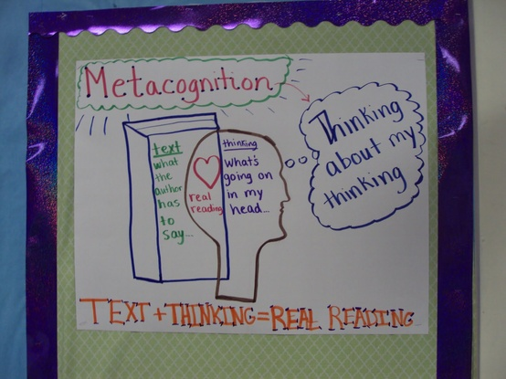
What is Metacognition? [4]
Courtesy: Teaching tool forum
[4] Joysula, D. P., Vadali, H., Donahue, B. J., & Hughes, F. C. (2009). Modeling metacognition for learning in artificial systems. In Proceedings of 2009 World Congress on Nature and Biologically Inspired Computing (NABIC 2009) (pp. 1419–1424). Piscataway, NJ: IEEE.

Slide 28
Definition of Metacognition
“The awareness and knowledge of one’s mental processes such that one can monitor, regulate and direct them to a desired goal”
As defined by J.H Flavell (1976)

Slide 29
Components of Metacognition…
Meta-knowledge
What is already known?
When an understanding has been accomplished
How that understanding was reached?
Why something is unknown/known?
Self-regulation?

Slide 30

What is self- regulation?
What is self-regulation?
An active constructive process whereby learners set goals, monitor, regulate, and control their cognitive and metacognitive process in the service of their goals
Provide role in collaborative learning
For effective learning, learners employ self- regulation [2],[3].
[2] Rivers, W. P. (2001). Autonomy at all costs: An ethnography of meta-cognitive self-assessment and self-management among experienced language learners. Modern Language Journal, 85(2), 279–290.
[3] Isaacson, R., & Fujita, F. (2006). Metacognitive knowledge monitoring and self-regulated learning: Academic success and reflections on learning. Journal of the Scholarship of Teaching and Learning, 6(1), 39–55.

Slide 31
Why Meta-cognition is important?
Learning
How-to-learn?
What-to-learn?
When-to-learn?
Helps to promote “Deep Learning”
Assessment for learning
Active role in assessing his/her own learning
Encourage to take responsibilities
Provide awareness

Slide 32
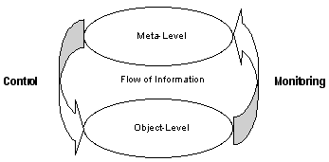
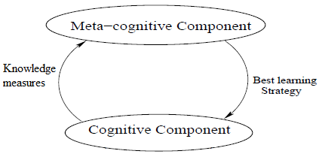
Nelson and Narens Model of Metacognition [9]
Cognitive component
Represent the knowledge
Metacognitive component
Represent dynamic model of the cognitive component
Signals
Control
Change the state of cognitive component or cognitive component itself
Initiate, or terminate or continue
Monitory
Inform about cognition
Metacognitive neural network
[9] Nelson T. O and Narens L, Metamemory: A theoretical framework and new findings, Psychology and Learning Motivation, 26, pp. 125-173, 1990.

Slide 33
Complex-valued Self-regulatory Resource Allocation Network (CSRAN)
Need for Self-regulation:
Assumption: uniform distribution of samples in the training data set:
not true, especially in real-world problems.
Presence of samples with similar information affect generalization ability of the network/ learning algorithm.
Need for selective participation of samples.

Slide 34
Complex-valued Self-regulatory Resource Allocation Network (CSRAN)
Key features
Fully Complex-valued ‘sech’ activation function
Complex-valued Extended Kalman Filter
Fully complex-valued gradients
Self-regulatory learning system
Sample deletion
Learning (Neuron addition/pruning, network parameter updates)
Reserve samples for future use.
Sequential learning

Slide 35
Complex-valued Self-regulatory Resource Allocation Network (CSRAN): Monitory Signals
Instantaneous Magnitude error
Instantaneous phase error

Slide 36
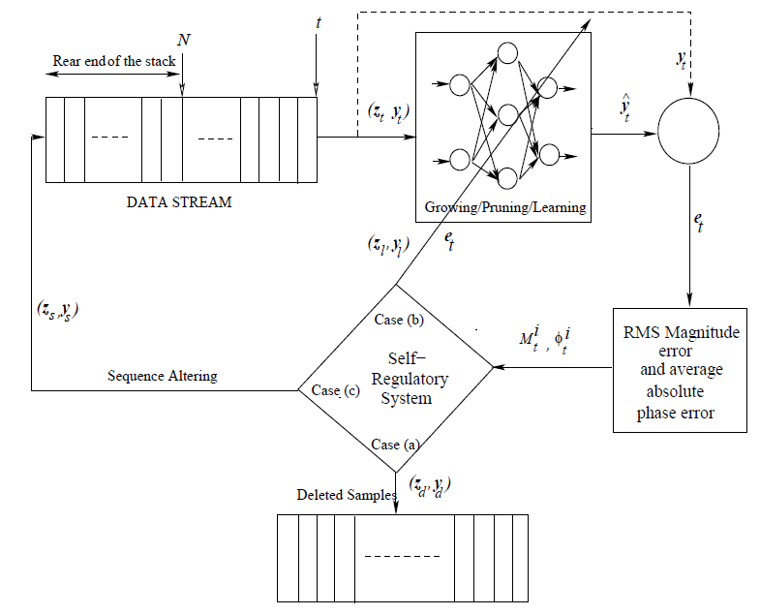
Complex-valued Self-regulatory Resource Allocation Network (CSRAN): Learning Algorithm

Slide 37
Complex-valued Self-regulatory Resource Allocation Network (CSRAN): Control Signal
Sample deletion:
Learning:
Neuron Addition
Network parameter update
Reserve Samples:
If neither sample deletion/learning

Slide 38
Complex-valued Self-regulatory Resource Allocation Network (CSRAN): Control Signal
Self-regulation:
Add control parameters:
Update control parameters:
Delete control parameters: No self-regulation

Slide 39
Complex-valued Self-regulatory Resource Allocation Network (CSRAN): Effects of Control
Parameters of an added neuron:
Network parameter update:
Fully complex-valued extended Kalman filter (C-EKF) [3].
Reserve samples:
Used in the future.

Slide 40
Complex-valued Self-regulatory Resource Allocation Network (CSRAN): The Gains!
Advantages:
Samples with similar information are deleted: no over-training.
Fully complex-valued activation function: Phase information preserved in forward computation
C-EKF: Phase preserved during backward computation
Self-regulation:
Samples with high information learnt first
Samples with less information learnt later
Insignificant samples are deleted.

Slide 41
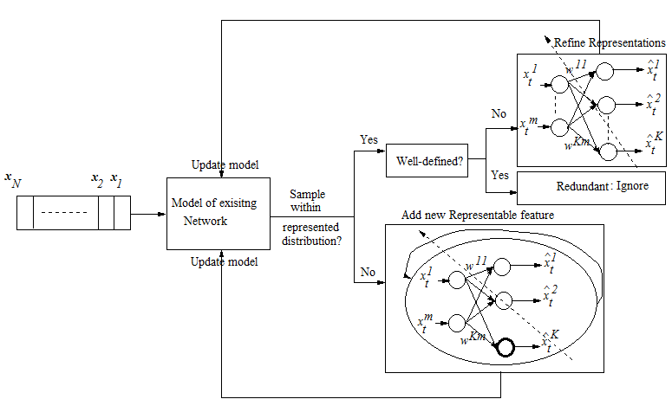
Towards Online Learning in Deep Neural Networks: Online Restricted Boltzmann Machine

Slide 42
Learning Strategies in Online RBM
Knowledge Measure
Feature Reconstruction error (e_{x});
Strategies:
Sample Selection: If e_{x} > E_{del}, choose the sample for representations.
Generate a Feature: If e_{x} > E_{add}, generate a new represented feature and initialize its weight. Update the weights of all the generated features to include this sample in the representations.
Refine representations: If e_{x} > E_{learn} & e_{x} < E_{add} , Update the weights of all the generated features, thus update the existing feature representational model.

Slide 43
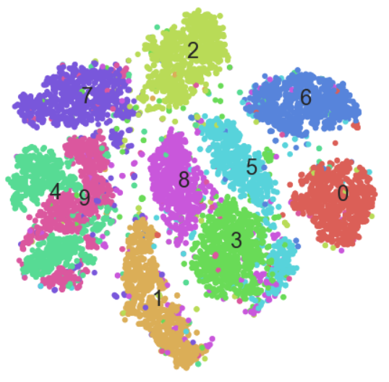
Generative Ability of Online RBM
Although single pass learning, the Online RBM has generative abilities
Inherently discriminative
Addition of a neuron to the hidden layer improves the representational power of RBM [13]
CD-1 often gives good results [14]
[13] N. L. Roux and Y. Bengio, “Representational Power of Restricted Boltzmann Machines and Deep Belief Networks,” 2008.
[14] Yoshua Bengio and Olivier Delalleau, “Justifying and Generalizing Contrastive Divergence,” 2008.

Slide 44
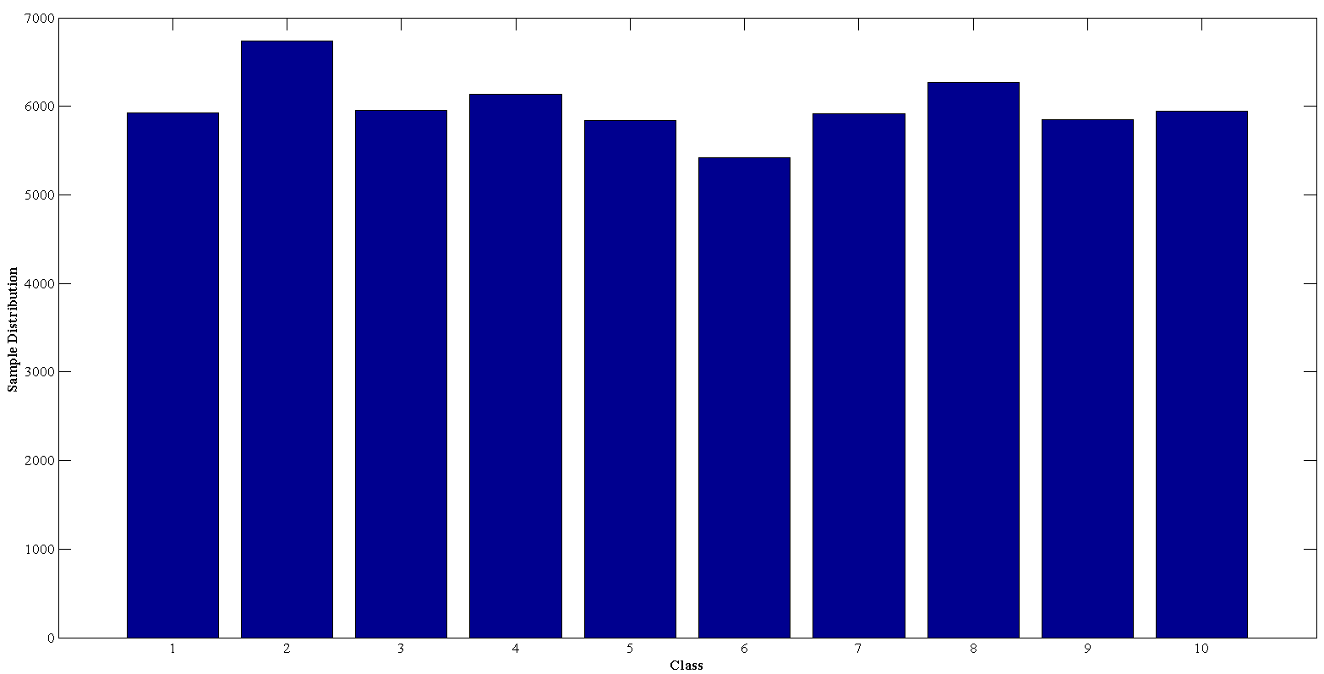
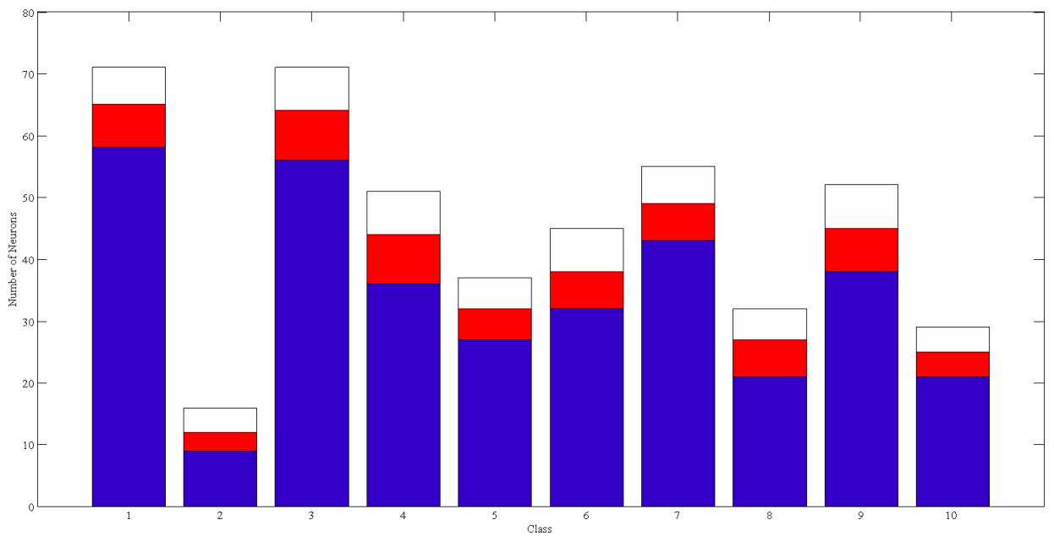
Online RBM: Neuron Distribution
Dataset: MNIST Handwritten character recognition
Experiment: 40 Trials-Changed sequence of sample presentation
Sample Distribution
Neuron Distribution
Accuracy Metrics:
Testing Overall: 96.86 %
Testing Average: 96.83%
Average Number of Neurons: 401

Slide 45
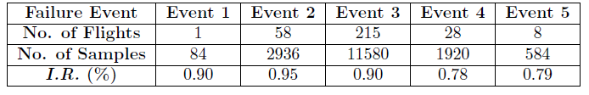
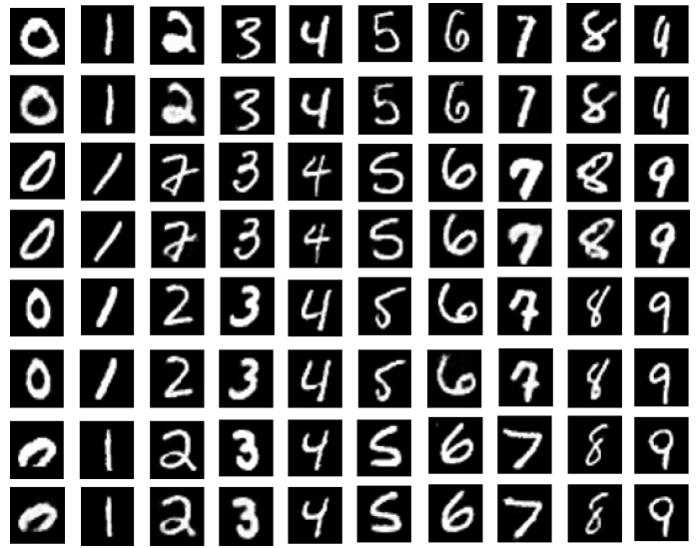
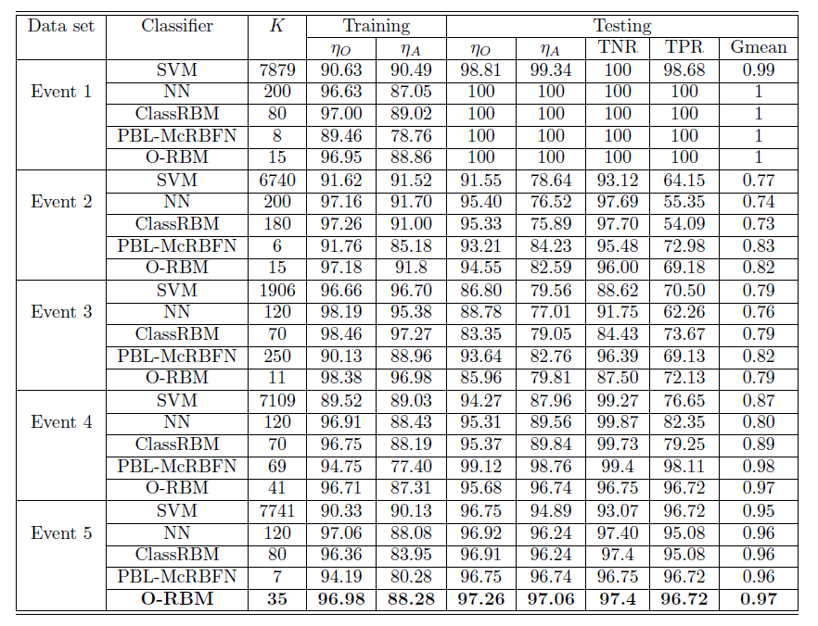
Online RBM: Demonstration and Evaluation
Supervised Classification: Time-series Datasets
Unsupervised Representation: Images

Slide 46
Continual Learning
Scenario 1
Scenario 2
Scenario n
New Data
New Labels/Classes

Slide 47


Desired Characteristics of Continual Learning
Remember learnings from the past!
Build on what you know, and grow as needed

Slide 48
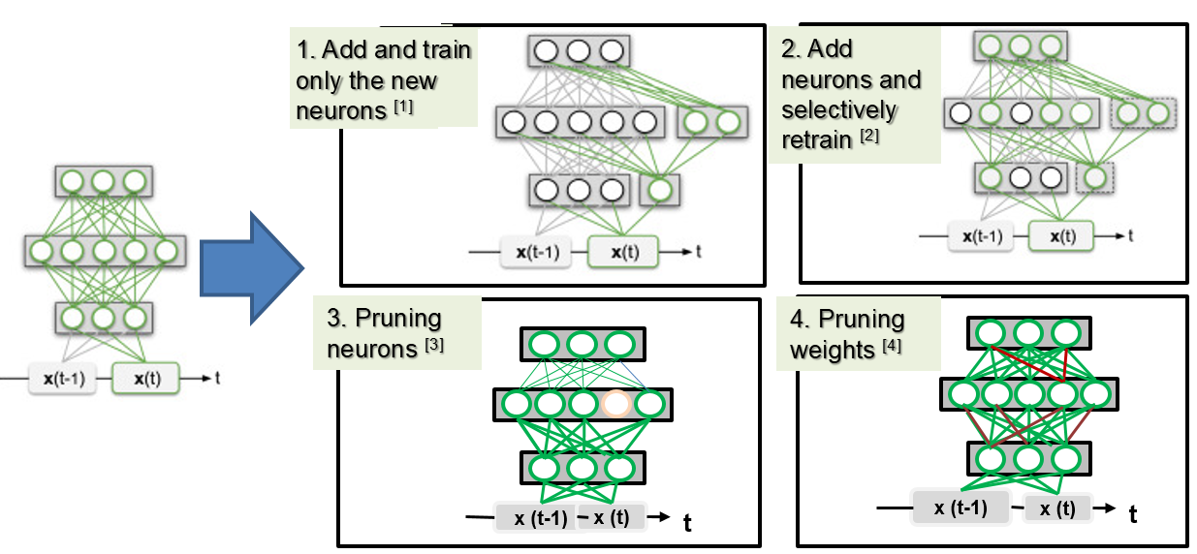
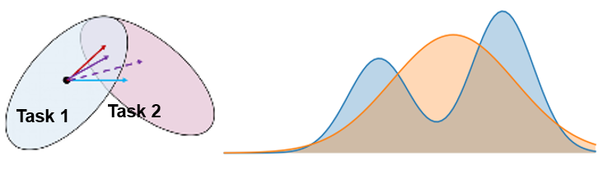
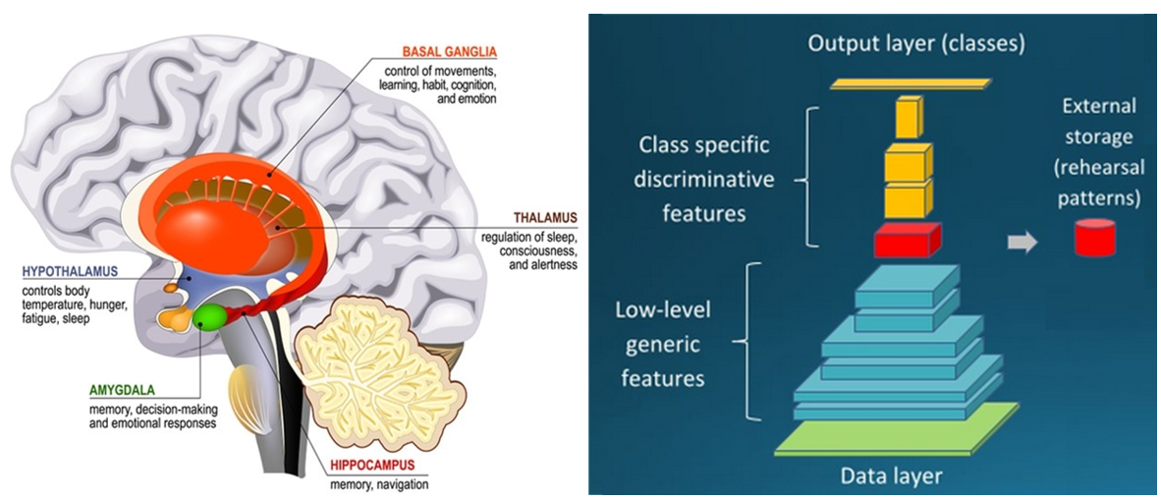
Strategies for Continual learning
Architectural Strategies ^{[1,2]}
Regularization Strategies ^{[3,4]}
Replay Strategies ^{[3,4]}
[1] SCY Hung et al., “Compacting, Picking and Growing for unforgetting continual learning, NeurIPS 2019.
[2] S. Ebrahimi et al.,”Uncertainty guided continual learning with Bayesian Neural Networks,” ICLR2020
[3] J. Kirkpatrick et al, "Overcoming catastrophic forgetting in neural networks,“ 2017.
[4] C. V. Nguyen, “Variational Continual Learning,” ICLR 2018
[5] H Shin et al, “Continual Learning with Deep Generative Replay,” NeurIPS 2019

Slide 49
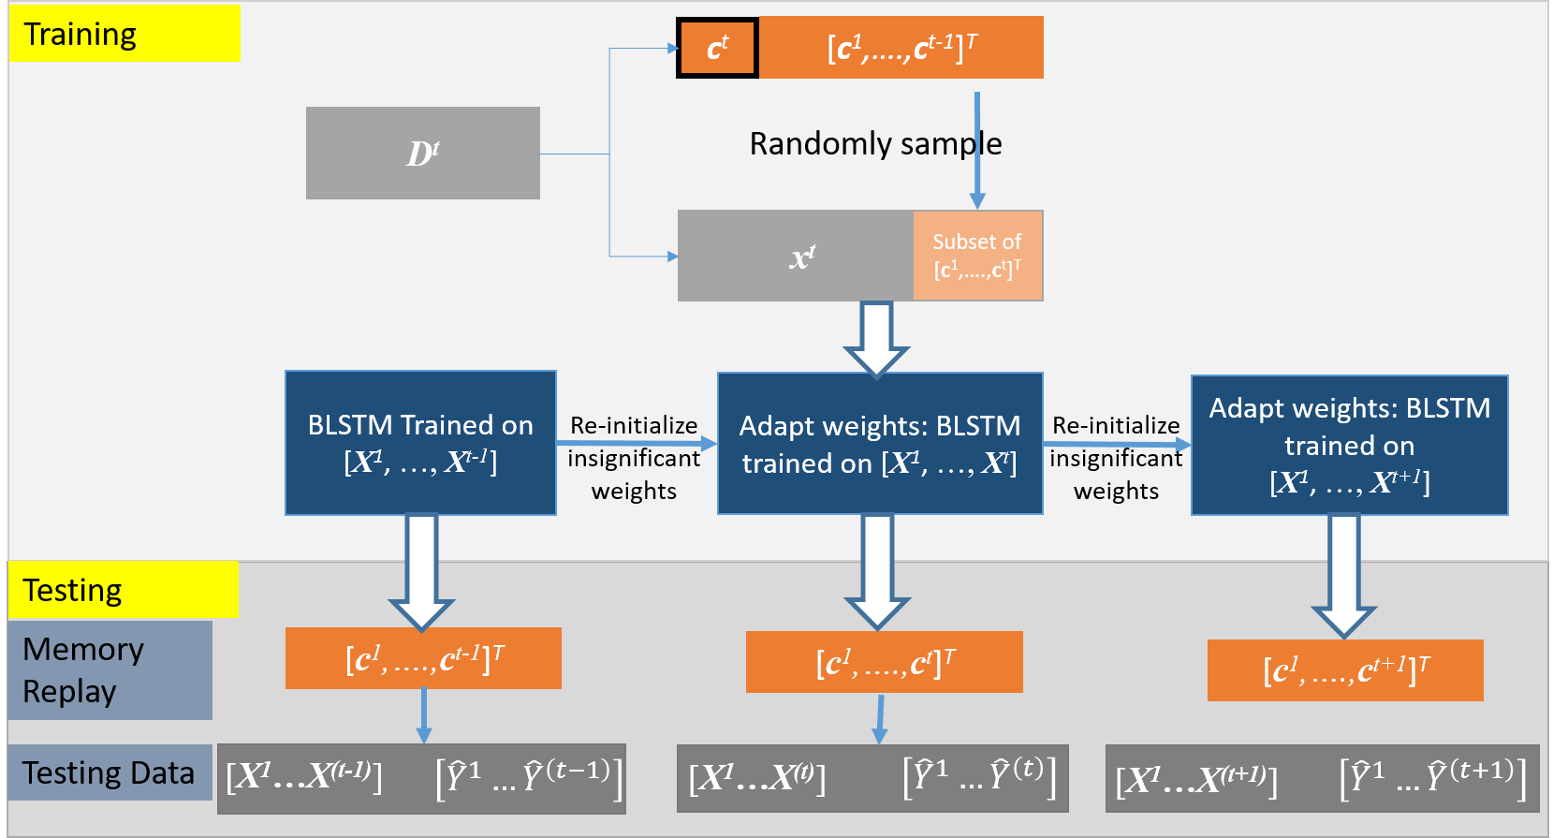
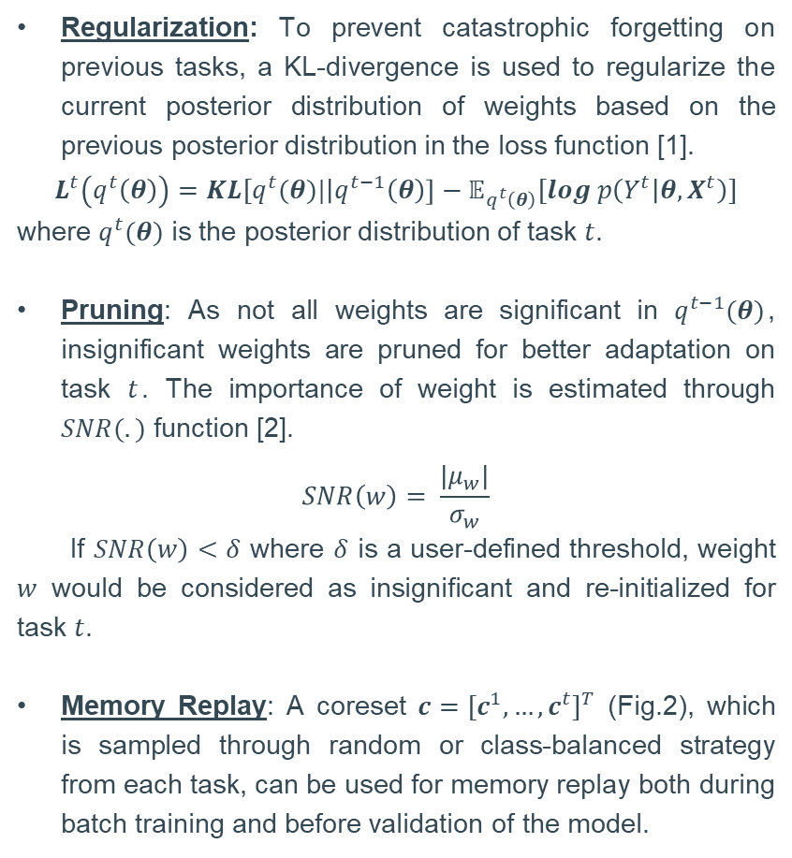
Continual Learning for Time Series Data
Strategies
Regularization: To prevent catastrophic forgetting on previous tasks, a KL-divergence is used to regularize the current posterior distribution of weights based on the previous posterior distribution in the loss function [1].
$$L^{t}\left(q^{t}\left(θ\right)\right)=KL[q^{t}(θ)|\left|q^{t−1}\left(θ\right)\right]−𝔼_{q^{t}\left(θ\right)}[log p\left(Y^{t} | θ, X^{t}\right)]$$
where $q^{t}(θ)$ is the posterior distribution of task $t$.
Pruning: As not all weights are significant in $q^{t−1}(θ)$, insignificant weights are pruned for better adaptation on task $t$. The importance of weight is estimated through $SNR(.)$ function [2].
$$SNR\left(w\right)= \frac{|μ_{w}|}{σ_{w}}$$
If $SNR\left(w\right)<δ$ where $δ$ is a user-defined threshold, weight $w$ would be considered as insignificant and re-initialized for task $t$.
Memory Replay: A coreset $c={{[c}^{1}, …,c^{t}]}^{T}$ (Fig.2), which is sampled through random or class-balanced strategy from each task, can be used for memory replay both during batch training and before validation of the model.
A Bayesian Approach for Continual Learning in Clinical Time Series, NeurIPS ML4H 2020.

Slide 50
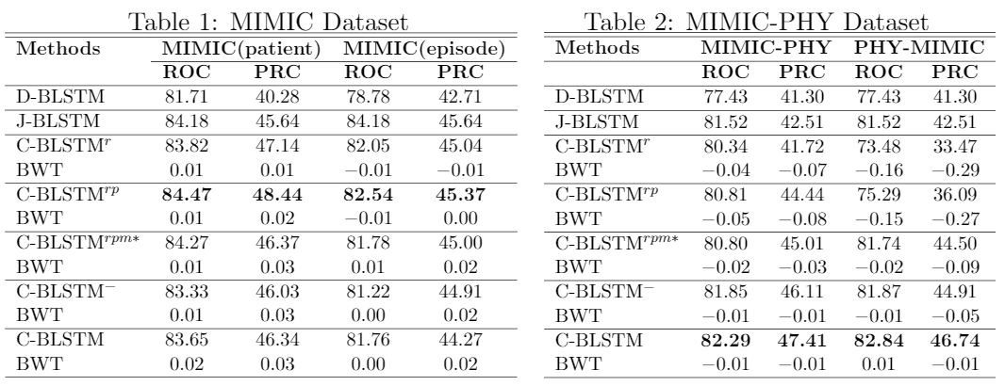
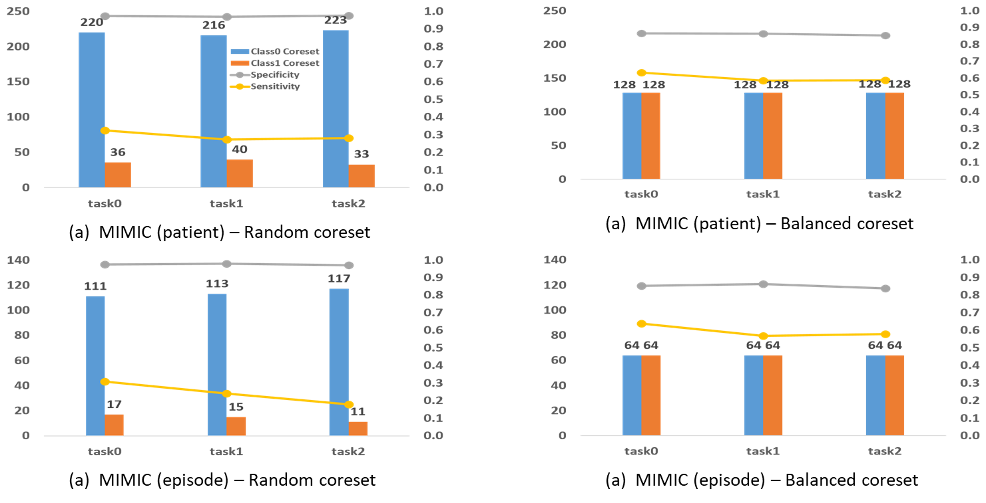
Evaluation of C-BLSTM

